Slide 1
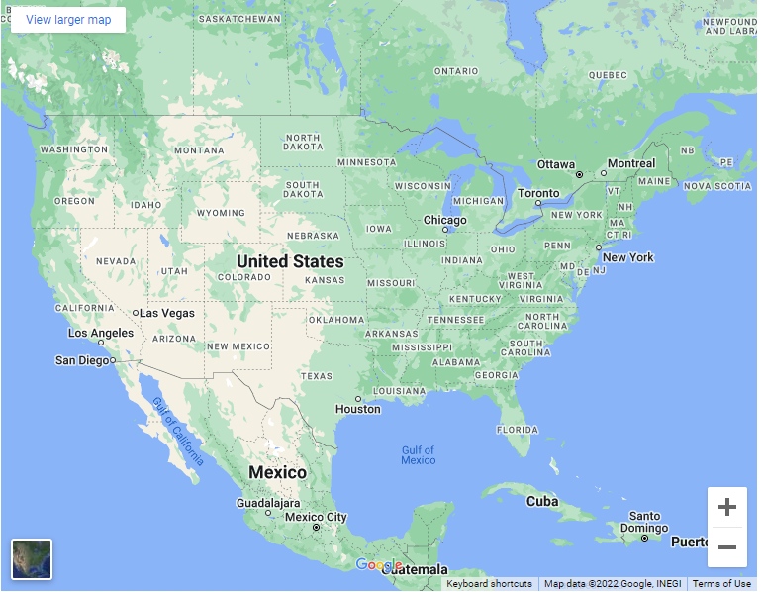
Group Name /
Website Name /
Logo
Mission Statement / Quote
MAU Level /
Details based on Filters selected
Top 10 Hospitals for treatment / Affordability
Machine Learning Graph /
Data points
Filters
State
County
Ethnicity
Heat Map for Total Incidents per State
Heat Map for Mortality per county
Age Range
Sex
Income Range

